Slide 1
SQL TUTorial
Notes:
Make sure everyone has downloaded SQLite, Sublime, DB Visualizer, and the baseball database before we start.

Slide 2
I. Installation and setup: sqlite, dbvis, and dataset ii. SQL syntax A. select statements, where, order by b. table joins, group by C. distinct, case, is not null d. Sub-queries e. create table ii. Using pandas and sql seamlessly
agenda

Slide 3
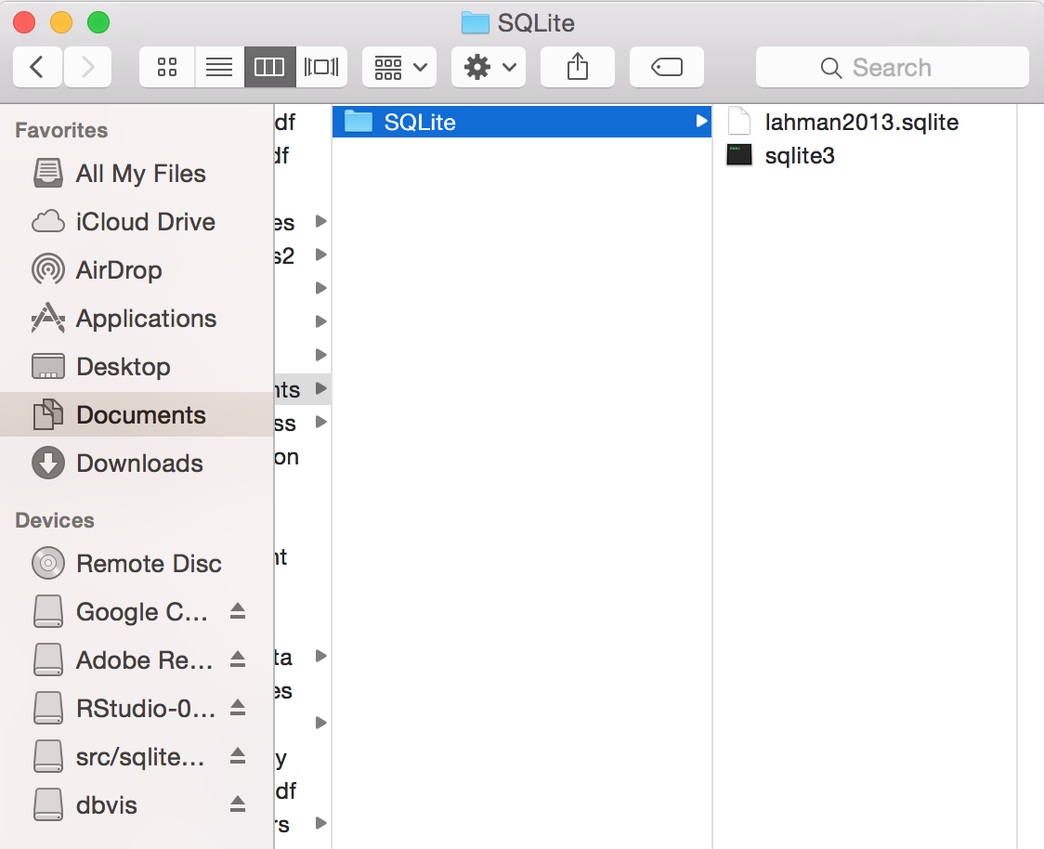
INSTALLATION AND SETUP
Create a new folder called ‘SQLite’ in your My Documents folder.
Unzip SQLite and drag the sqlite3 application into the folder you just created.
Move the Baseball dataset to the SQLite folder.
Open Sublime Text Editor.
Open DBVisualizer.

Slide 4
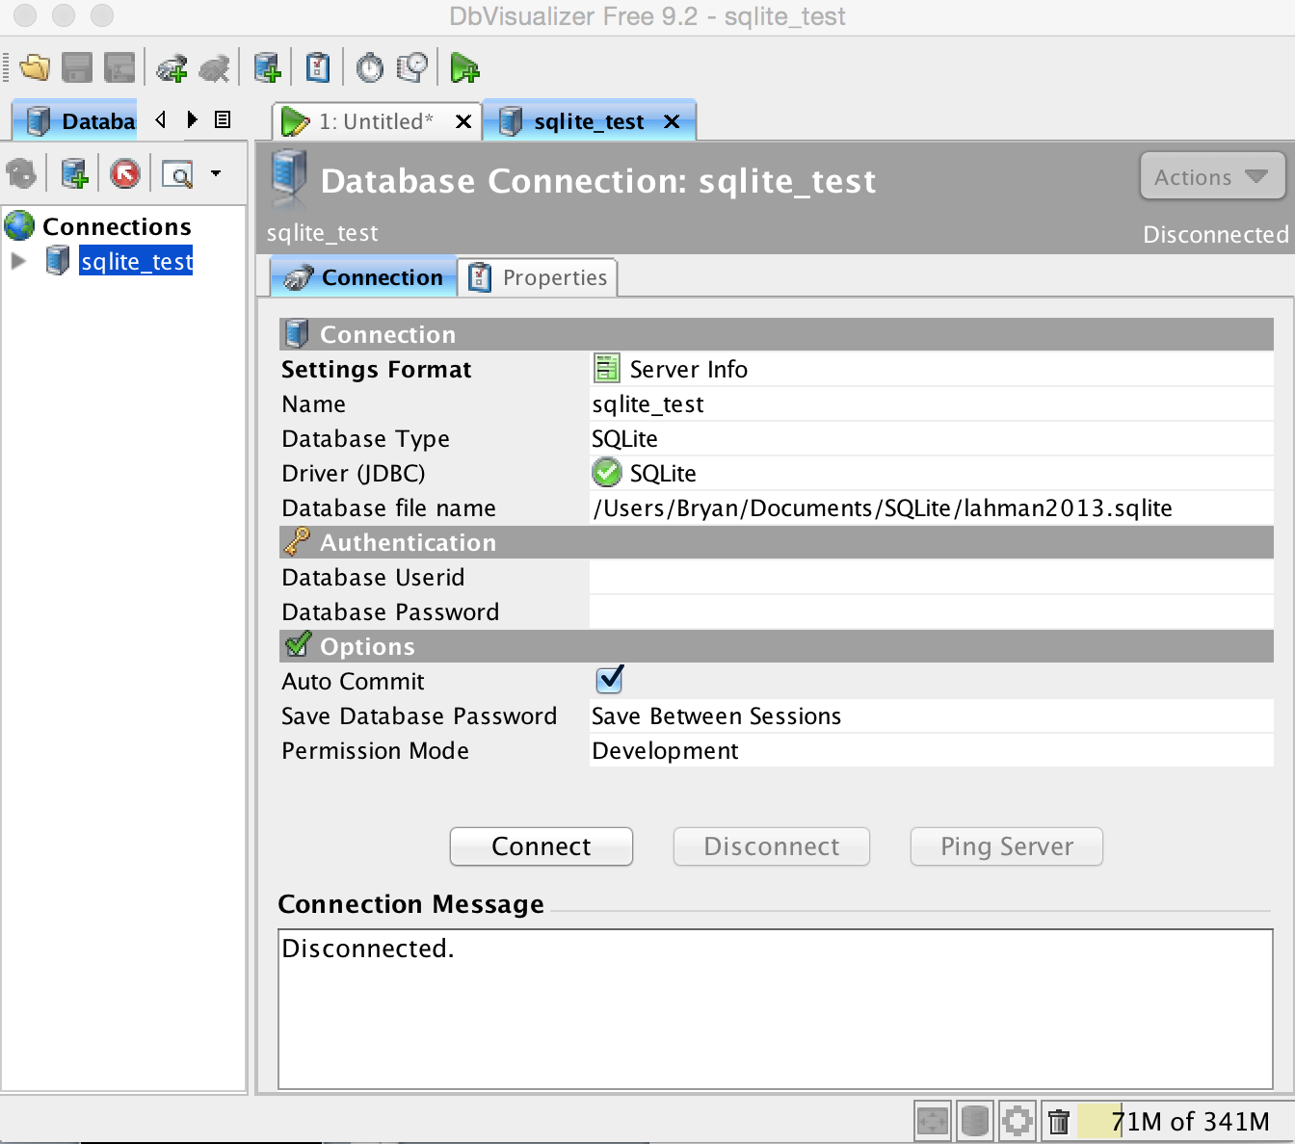
INSTALLATION AND SETUP
In DBVisualizer, go to Database -> Create Database Connection.
Click ‘No Wizard’ in the ‘Use Connection Wizard’ prompt.
You should see the window to the right appear.

Slide 5
INSTALLATION AND SETUP
Under ‘name’, name your database. I suggest ‘baseball_stats’ to start.
Under ‘Database Type’, select SQLite.
Under ‘Driver (JDBC)’, select SQLite.
Insert the path to the baseball dataset file under ‘Database File Name’.

Slide 6
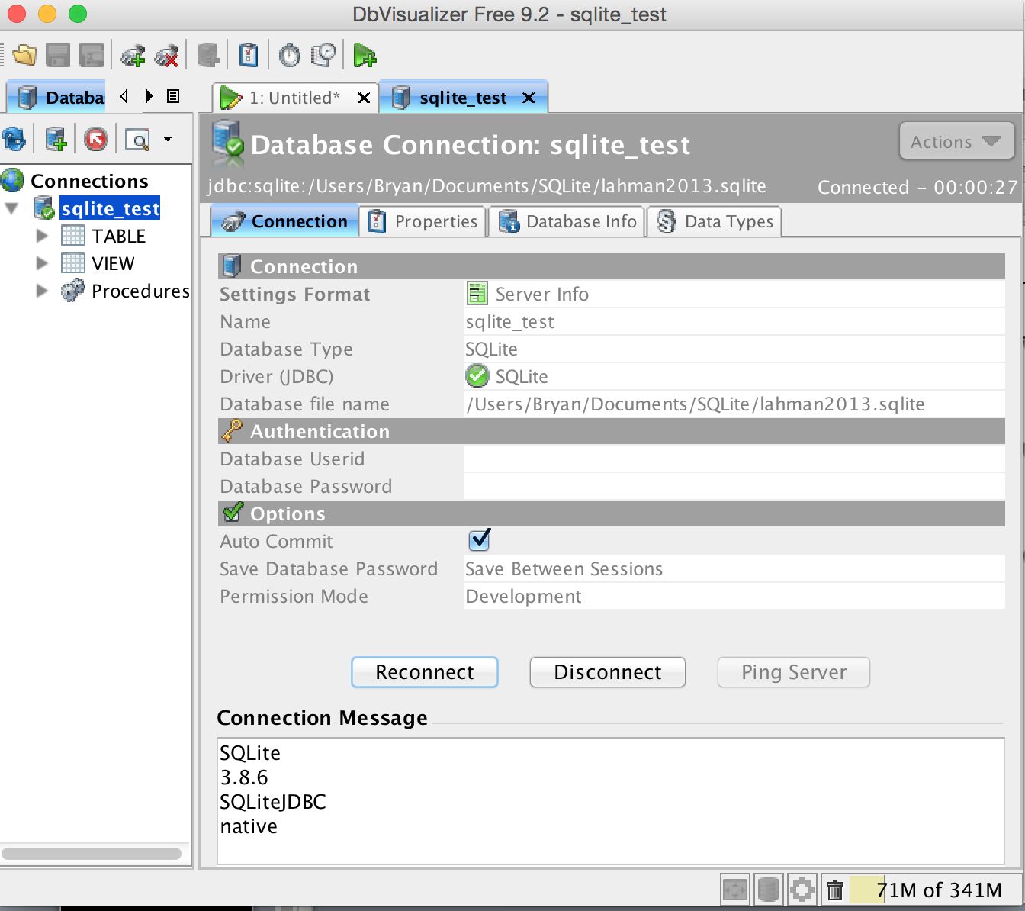
INSTALLATION AND SETUP
Do not put in a database user id or password.
Click ‘Connect’. You should see ‘SQLite’ appear under ‘Connection Message’ and the other options go gray.
If the connection failed, check the path to the database file – it should not be quoted.

Slide 7
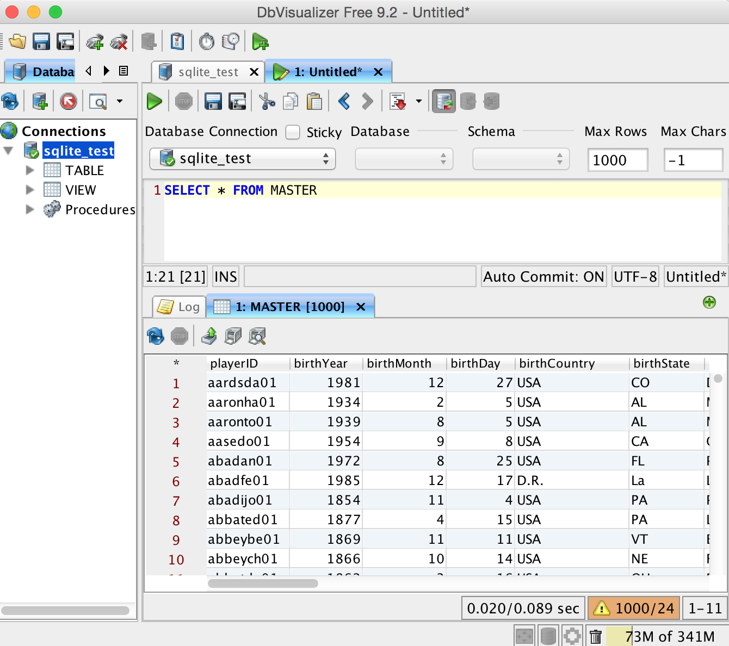
INSTALLATION AND SETUP
Go to SQL Commander-> New SQL Commander.
Type SELECT * FROM Master; and type Command-Enter.
You’ve run your first SQL query!
Pressing the down arrow on TABLE lets you see all the tables in the database.

Slide 8
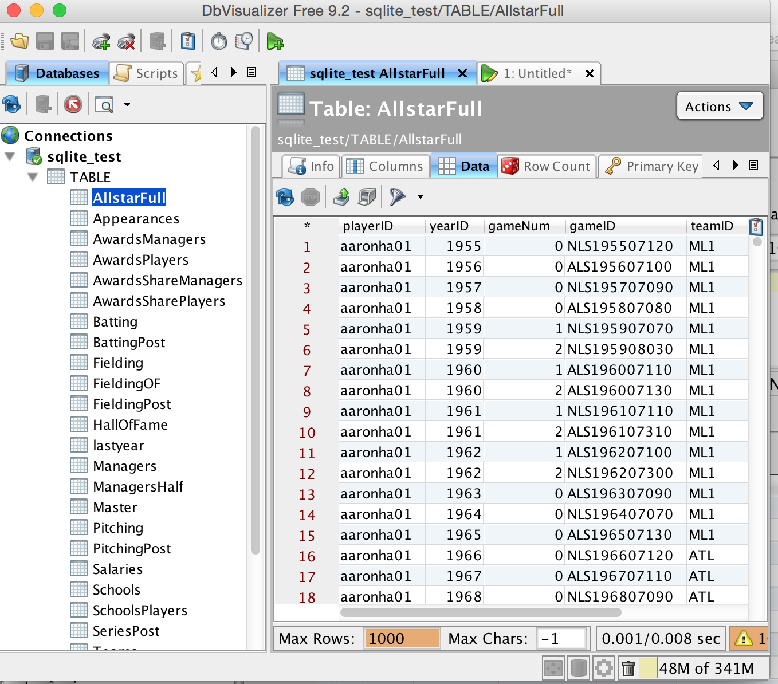
INSTALLATION AND SETUP
Double-click on a table to see its information such as columns, data, and indexes.
Press the ‘Data’ tab to see what the table looks like.
Go back to your SQL Commander window so that we can begin writing queries.

Slide 9
SQL: select statements
The SELECT statement is basis of most analytic queries you will write. It lets you select all the data in a particular table.
You designate the name of the table in the FROM clause. All SQL statements should end in a semicolon.
SELECT * FROM {table}; lets you select ALL the columns in the table.
SELECT {colname1}, {colname2}, {colname3} FROM {table}; lets you select only the columns you want from the table.
SELECT {conmane1} as your_name FROM {table) lets you give your own designated alias name to the column in the SQL output.

Slide 10
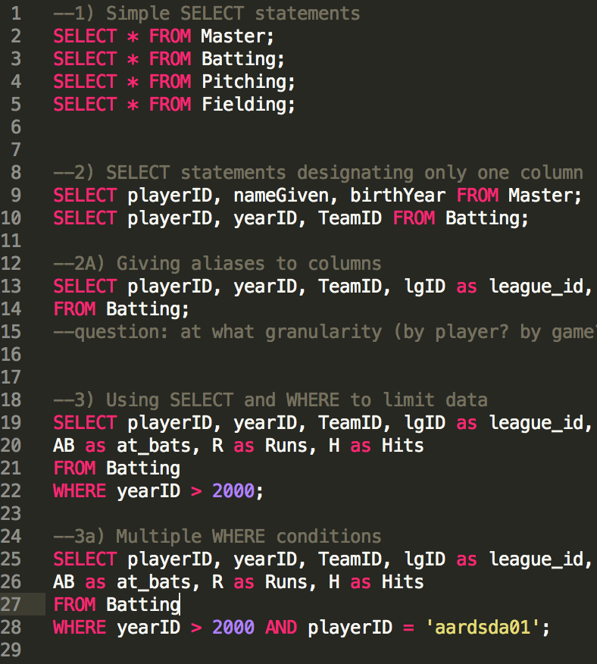
Exercise: select statements
Select all the data in the table named ‘Master’.
Select all the data in the table named ‘Batting’.
Select only the columns in ‘Master’ named playerID, nameGiven, and birthYear.
Select only the columns in ‘Batting’ named playerID, yearID, and TeamID.
In ‘Batting’, select and give the following aliases to lgID, G_batting, AB, R, and H: league_id, games, games_as_batter, at_bats, runs, and hits.

Slide 11
SQL: THE where CLAUSE
The WHERE clause lets you designate limits to the rows selected by SQL, and goes after FROM in the SELECT statement.
The syntax is: SELECT {columns} FROM {table} WHERE {condition};.
The >, <, <=, >=, =, !=, OR, AND, IS/IS NOT NULL, BETWEEN, and IN operands are available for use in the WHERE clause.
Numbers are supported natively, strings and textual dates must be enclosed in apostrophes.
Multiple conditions can be added to the statement using AND.
The in({element1},{element2}) feature lets you select rows where a column value is in a list.

Slide 12
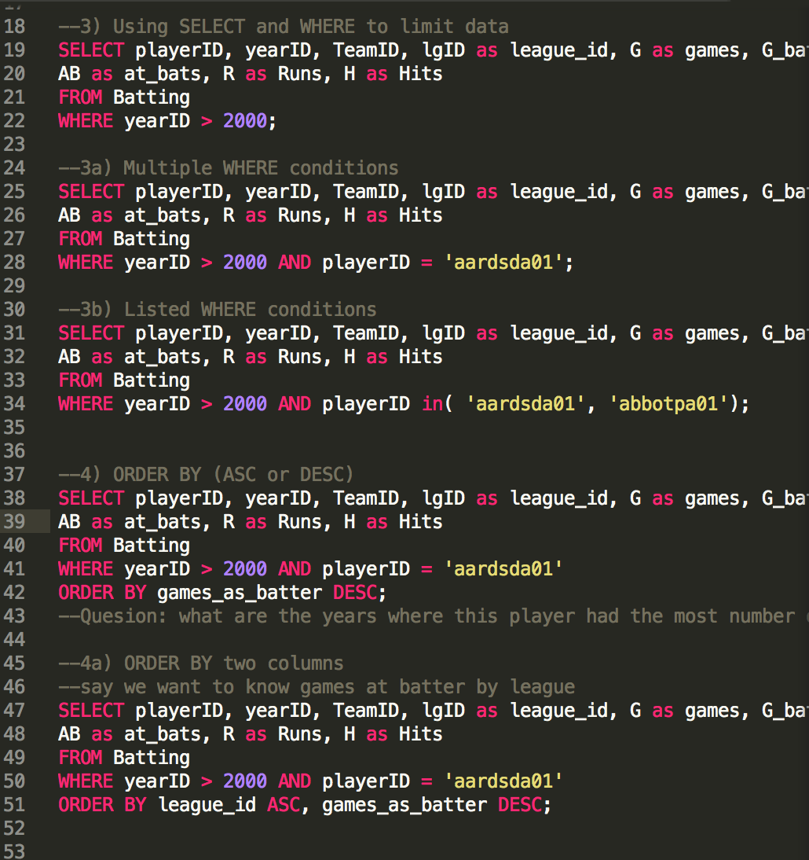
Exercise: the where clause
Open Sublime Text Editor and create a new file named sql_tutorial.sql in your ‘My Documents’ folder. Save your your SQL commander text to the new file.
Select all rows in ‘Batting’ with yearID greater than 2000.
Select all rows in ‘Batting’ with yearID greater than 2000 and with the playerID of ‘aardsda01’.
Select all rows in ‘Batting’ with yearID greater than 2000 and with the playerIDs in a list containing 'aardsda01’ and 'abbotpa01’.
Notes:
Note that we’re using Sublime Text to save your SQL as DBVis free Edition doesn’t let you have multiple SQL statements in one file.

Slide 13
SQL: ORDER BY
ORDER BY lets you order the data returned by the SELECT clause according to one or more columns.
The syntax is: SELECT {columns} FROM {table} WHERE {conditions} ORDER BY {column};
Put ASC or DESC after the column name to designate whether you want the data in descending order (highest to lowest) or ascending order (lowest to highest).
You can order by multiple columns with the following syntax: ORDER BY {column1} (ASC/DESC), {column2} (ASC/DESC).
ORDER BY works for most data types you will encounter, including numeric, string, and date data.

Slide 14
Exercise: order by
Save your last query to Sublime.
Alter your last query to be ordered by games_as_batter in descending order.
What are the years where this player had the most number of games at bat?
Add another column to ORDER BY so that we first order by league ID in ascending order, and then in games at bat in descending order.
Notes:
--Quesion: what are the years where this player had the most number of games at bat?

Slide 15
SQL: TABLE JOINS and aliases
Table joins return different tables joined together by a common index.
The syntax is: SELECT t.{columns}, t2.{columns} FROM {table} t (LEFT / RIGHT / INNER) JOIN {table} t2 ON {common index};
LEFT JOIN returns the first table you designate in full, and has NULL values for those rows that do not have a corresponding index in the second table. INNER JOIN returns only those rows with a common index, all rows that don’t have one are not returned.
As the two tables may share column names, we add table aliases (ie t2.column and t1.column in both the SELECT and JOIN clauses. We designated the aliases at the start of the JOIN clause.
Be aware of many-on-one joins, and one-on-many joins if the index is non-unique in one or both of the columns.
Notes:
Table joins are the bread and butter of SQL – so pay close attention!

Slide 16
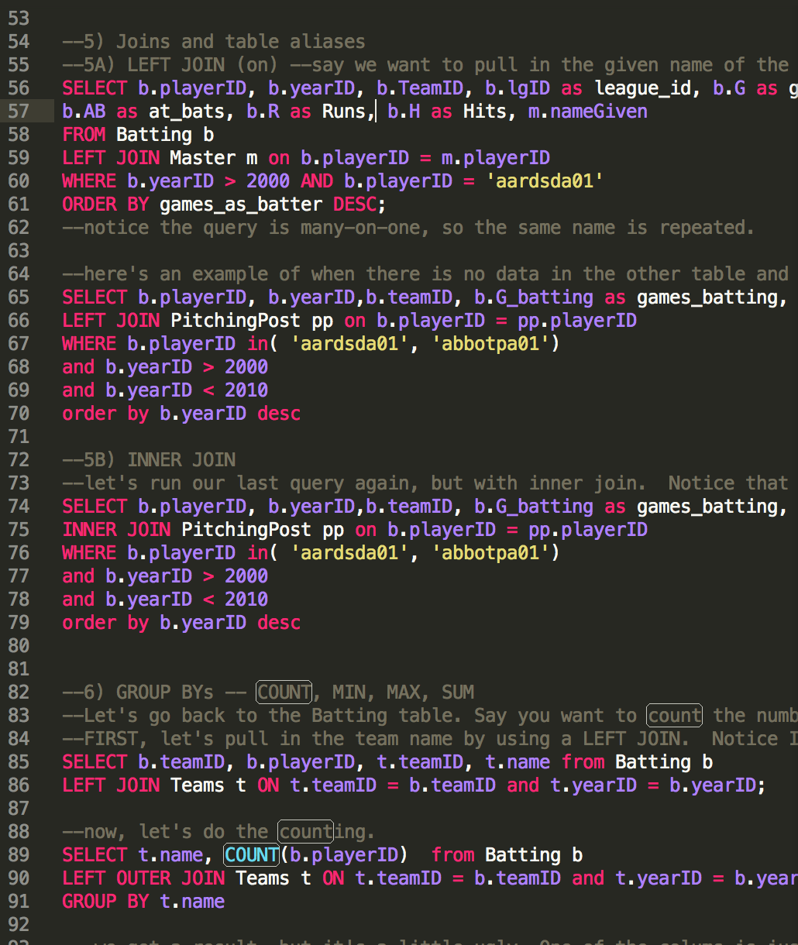
Exercise: JOINS
Save your last query to Sublime.
LEFT JOIN ‘Batting’ to Master on Batting.playerID = Master.playerID
Only select the nameGiven column from Master and relevant statistics (year, team, league, games, games_as_batter, at_bats, hits, and runs) from Batting so that we can get a concise view of a player’s profile. Remember to use table aliases!
Repeat the same process with an INNER JOIN.

Slide 17
SQL: the group by clause
The GROUP BY clause aggregates data by a column dimension.
The syntax is SELECT {column1} (COUNT/MIN/MAX/AVG/SUM)({column2}) WHERE {conditions} GROUP BY {column1};
GROUP BY lets you answer questions like – how many players are there per team? What’s the average number of at-bats for a player? What’s the total number of at-bats for a player?
You can GROUP BY more than one table column to get more granular aggregation. Ex: what’s the average number of at-bats for a player at each team they played on.
Combine GROUP BY with ORDER BY to rank aggregate statistics. Ex: what are the players with the top number of at-bats per year?
Notes:
Table joins are the bread and butter of SQL – so pay close attention!

Slide 18
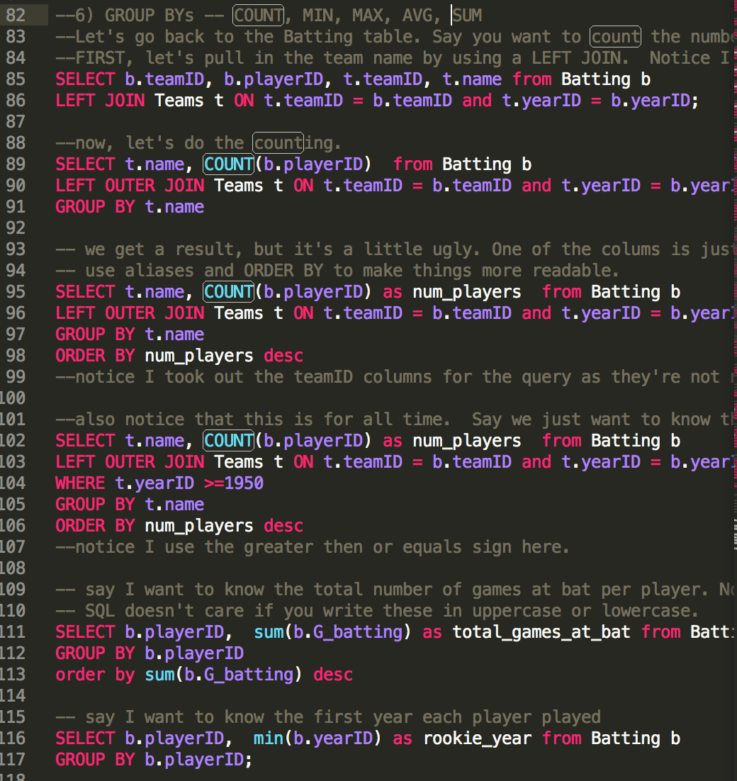
Exercise: GROUP BY
LEFT JOIN the Batting table to the Teams table on two common indices: teamID and yearID.
Count the number of player IDs per team name. Enhance your query by ordering the output by the number of players per team. Limit your query to data on or after 1950.
Find the top players by total number of games at bat in the Batting table.
Get the rookie year (ie the minimum year) of every player in the Batting table.
Notes:
Make sure to save your last query to Sublime!

Slide 19
SQL: distinct and case
Adding DISTINCT to the SELECT statement returns only unique entries in a column.
The syntax is SELECT DISTINCT {colname} FROM {table};
DISTINCT is useful when used with GROUP BY. Ex: what are the number of unique player IDs in the Batting table?
CASE statements let you create a new column based on conditions in another column.
The syntax is SELECT CASE WHEN {colname} = {condition} THEN {output when true} ELSE {output when false} END FROM {table};
This is useful when you want to create a new label for your data, such as flagging players with a large number of at-bats.
Notes:
Table joins are the bread and butter of SQL – so pay close attention!

Slide 20
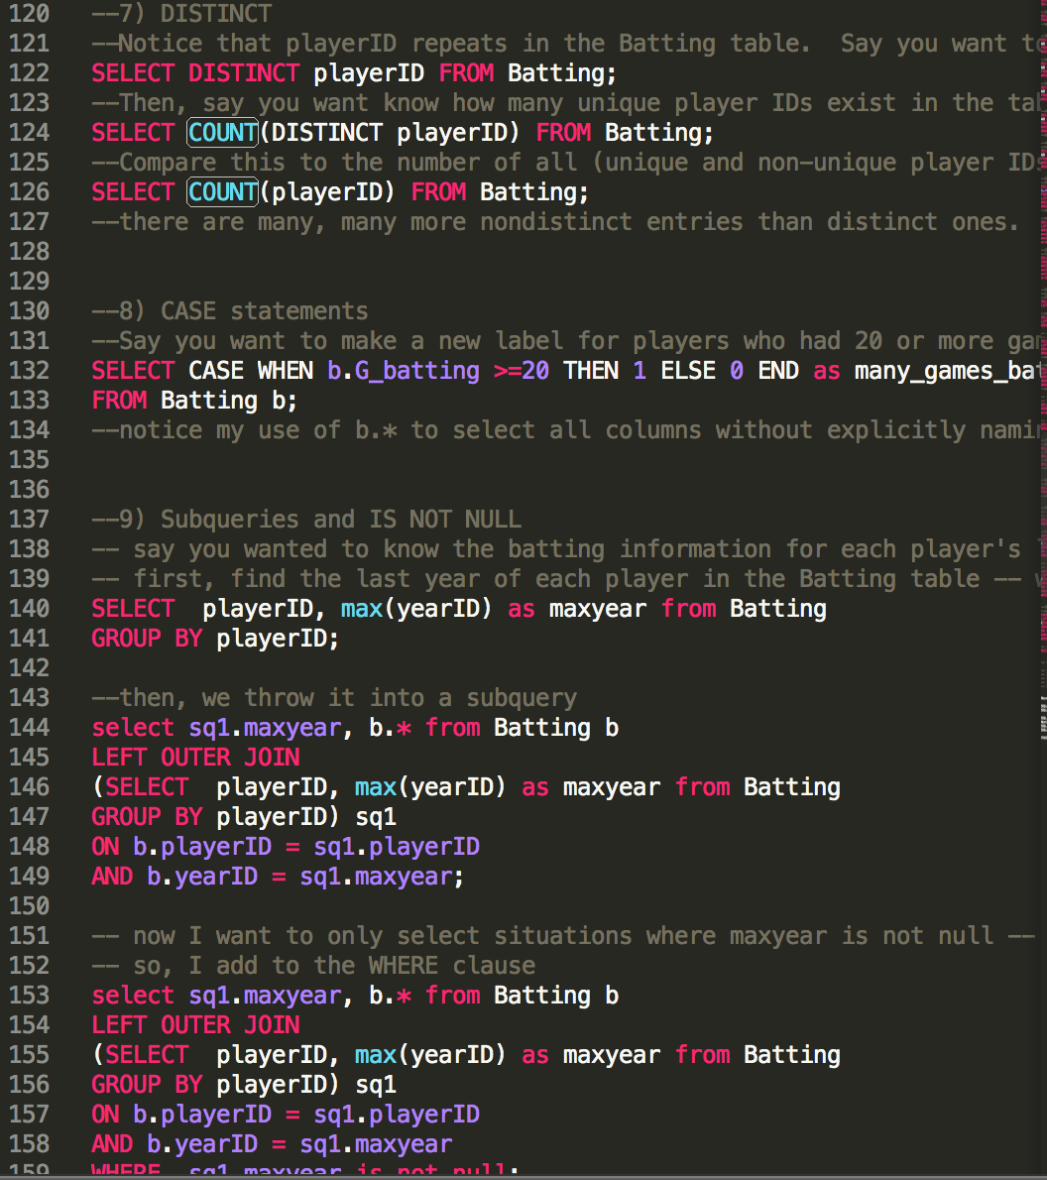
Exercise: DISTINCT AND CASE
SELECT the distinct player IDs from the Batting table.
COUNT the number of distinct IDs, and then count all the IDs. Look at the difference in the COUNT.
Create a new column called many_games_batted using CASE that has a 1 if a player batted 20 or more games in a season and 0 if a player batted fewer than 20 games.
Notes:
Make sure to save your last query to Sublime!

Slide 21
SQL: SUBQUERIES
Subqueries are a very helpful way to join information you’ve already grouped or altered to an existing or other altered table.
Example: What was the batting information for a player’s last year?
The syntax is: SELECT {t1.columns}, {t2.columns} FROM {table1} t1 LEFT OUTER JOIN (SELECT {columns} FROM {table2}) t2 ON t1.{joint key} = t2.{joint key};
In effect, your subquery SQL statement is treated like just another table in the outer SQL statement.
Notes:
Table joins are the bread and butter of SQL – so pay close attention!

Slide 22
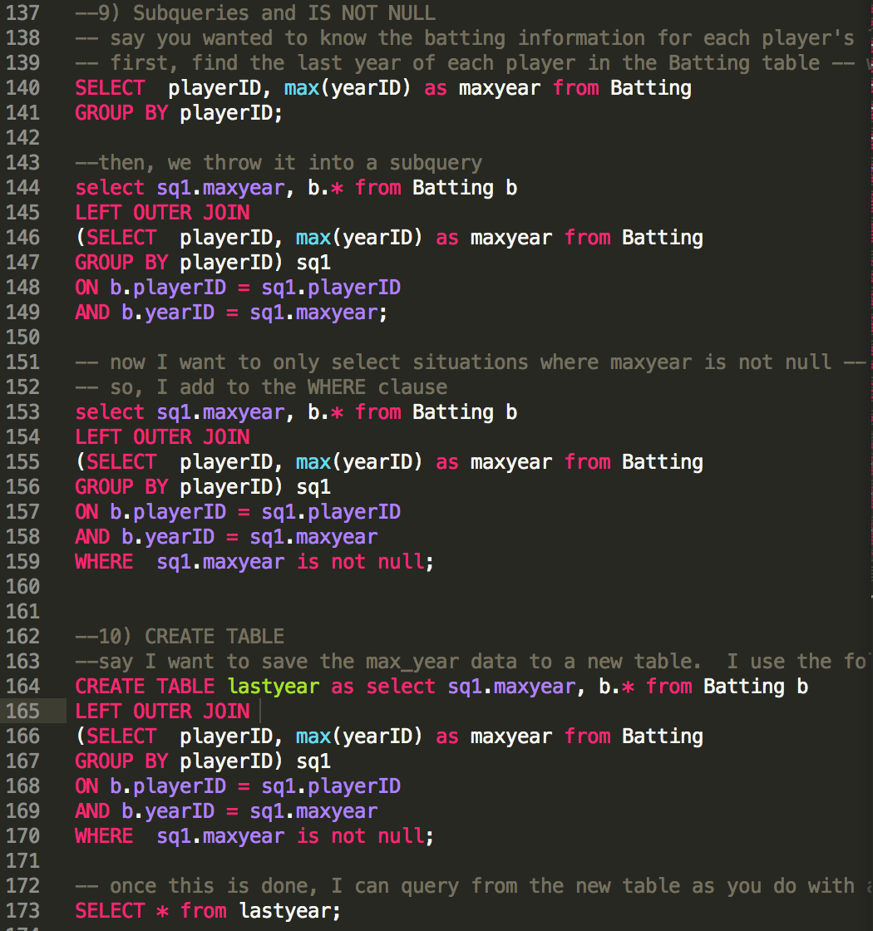
Exercise: SUBQUERIES
Find the last year of each player in the Batting table using MAX() and GROUP BY.
Move that SQL into a sub-query and left join it back to Batting on the two common keys: playerID and year.
Add a condition in the WHERE clause so that we only return rows where the year in the subquery is not null. This shows the batting information only for each player’s last year.
Notes:
Make sure to save your last query to Sublime!

Slide 23
SQL: CREATE TABLE
New tables in the SQL database can be made using the CREATE TABLE syntax.
For this lesson, we will only create tables from SELECT statements, but be aware that you can also create empty tables and add new rows using INSERT INTO.
The syntax for creating a table is: CREATE TABLE {new table name} AS {SELECT statement};
Once the table is created, you can access it via regular SELECT statemenets.
Notes:
Say we’ll create tables using Pandas in this class.

Slide 24
Exercise: CREATE TABLE
Create a table of the results of the last subquery you created.
Query your new table using a SELECT statement.
Notes:
Make sure to save your last query to Sublime!

Slide 25
PANDAS AND SQL
Pandas interfaces with SQL via its pandas.read_sql() method.
With read_sql(), you pass a connection (made via the sqlite3 package) and a string containing your SQL.
read_sql() returns a dataframe with the results of your query.
Pandas.DataFrame.to_sql() writes a DataFrame back to your SQL database.
The if_exists option lets you designate what happens if the table you’re asking to create already exists. You can either replace the table with the DataFrame you’re writing, append to the existing table, or have the function fail.
Notes:
Say we’ll create tables using Pandas in this class.

Slide 26
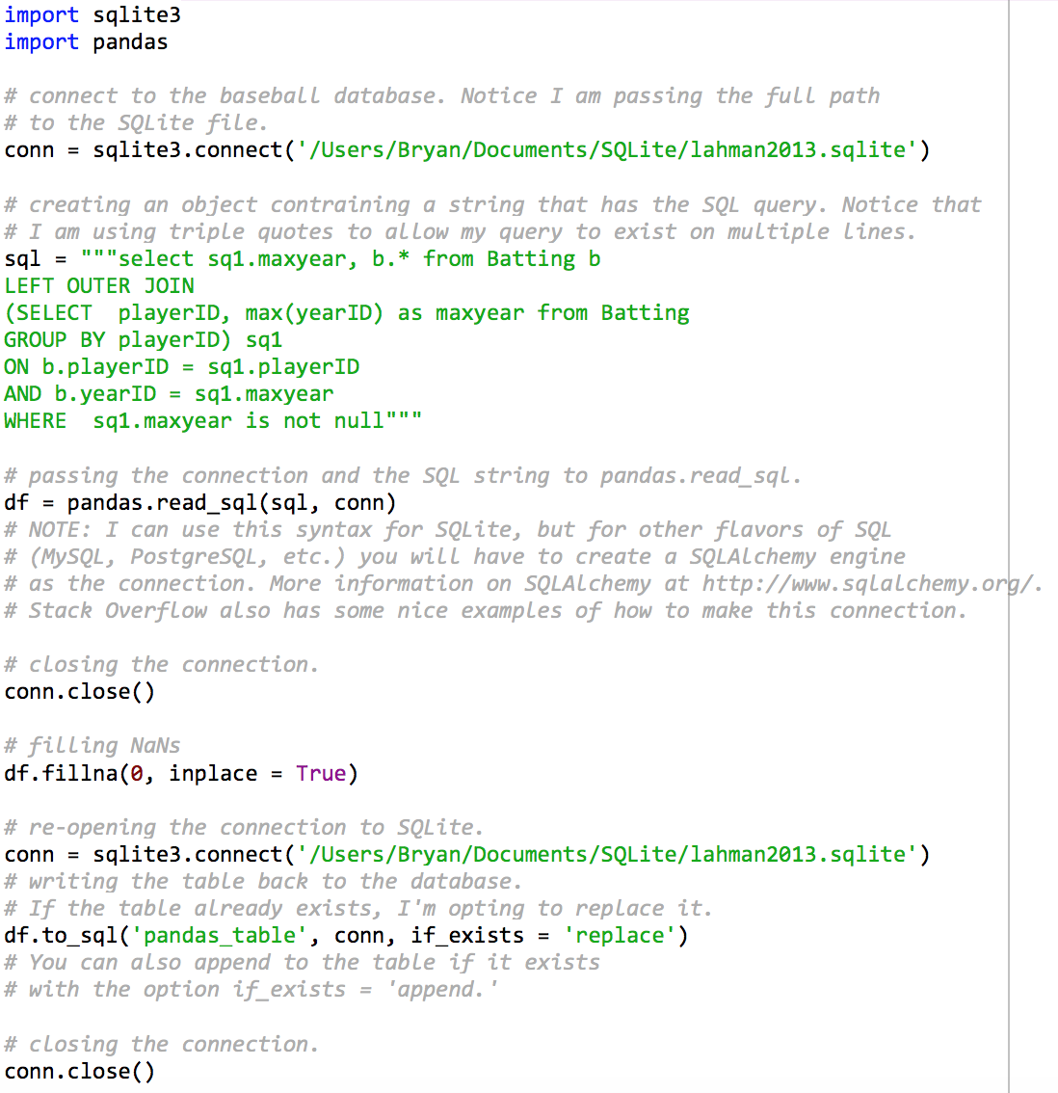
Exercise: PANDAS AND SQL
Import sqlite3 and connect to your SQLite database.
Pass the SQL from your last in-class exercise to a string.
Use the pandas.read_sql function to retrieve the results of your SQL into a pandas DataFrame.
Fill the DataFrame’s NANs with zero.
Write the DataFrame back to your database in a table called ‘pandas_table’.
Notes:
Make sure to save your last query to Sublime!

Slide 27
IN-CLASS WORK: sql
Find the player with the most at-bats in a single season.
Find the name of the the player with the most at-bats in baseball history.
Find the average number of at_bats of players in their rookie season.
Find the average number of at_bats of players in their final season for all players born after 1980.
Find the average number of at_bats of Yankees players who began their second season at or after 1980.
Pass #5 into a pandas DataFrame and write it back to SQLite.

Slide 28
Questions?
SQL TUTORIAL

